Slide 1


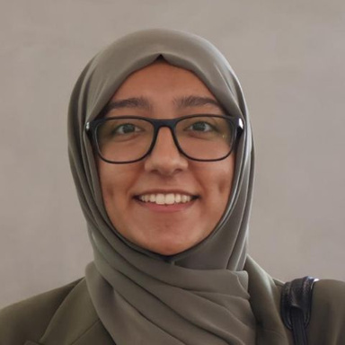




Breaking Into International Organisations (UN, WTO & More)
PATHS TO PRACTICE LIVE | SESSION 3
Want to work at the UN, WTO or similar organisations?
Join a practical conversation on how to apply, what to expect, and how to stand out at the UN, WTO and beyond.
With Saira Munir
Former Intern at the World Trade Organization and Pakistan’s Permanent Mission to the United Nations
Sunday, Feb 22
04.00 PM (GST)
@halalaw.ae | www.halalaw.ae

Slide 2
WHAT IS HALA LAW?
A UAE-focused legal careers and professional development platform.
WHAT ARE OUR GOALS?
Supporting aspiring and early-career lawyers with honest, practical insight
Bridging the gap between law school, qualification routes, and real legal careers
Building community through resources, events, and candid conversations

Slide 3
WHAT YOU’LL GET TODAY:
3.
Applying to international organisations
5.
Resumes and cover letters
1.
Meet Saira
+ her journey
WTO application process
4.
What makes candidates stand out
6.
Q&A
2.

Slide 4
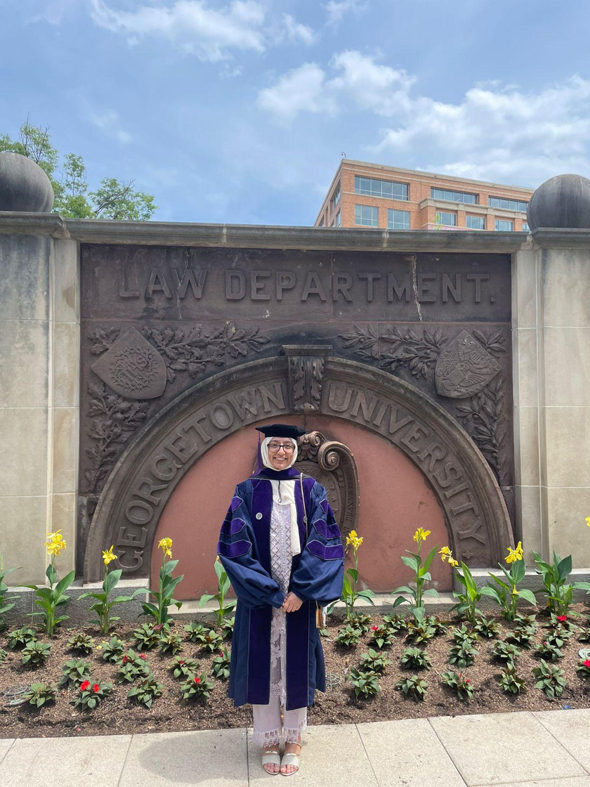
About me
King’s College London (LLB with Transnational Law) and Georgetown University (LLM in International Law)
At university, I built up skills working in the legal clinic, mooting competitions, and as an environmental law fellow
Following graduation, joined the World Trade Organization and then Pakistan’s Mission to the United Nations

Slide 5
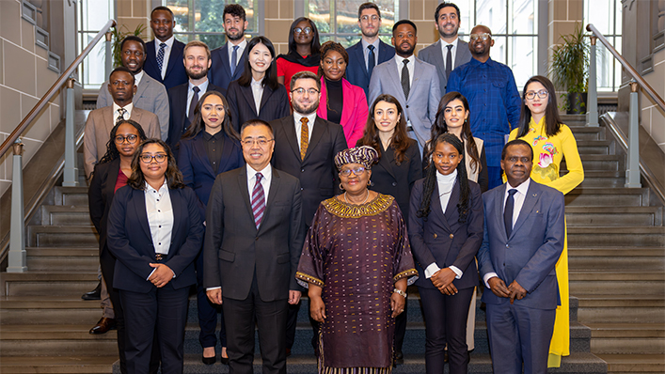
Entry-level roles at the WTO
Young Professionals Programme (YPP)
One-year, paid programme (approx. CHF 4,000/month)
Designed for early-career professionals (minimum 2 years’ experience)
Requires an advanced degree in law, economics, or trade-related fields
Open from around March to April
Young Trade Leaders
You’re given a platform within the WTO to speak and share ideas on trade
Not a paid role, but you do get a massive spotlight and great networking opportunities.
Internships
General Internship Programme: Open to post-graduate students from all WTO members. Also open to students from countries or customs territories engaged in accession negotiations
China Accession and General Programme
WTO Support Programme for Doctoral Studies: This is research-focused. Participants receive mentorship from a WTO official and support for their doctoral thesis
Link to Workday:
https://www.wto.org/english/thewto_e/vacan_e/iypp_e.htm
The China and PhD programmes are reserved for post-graduate students from developing countries and Least Developed Countries (LDCs)

Slide 6
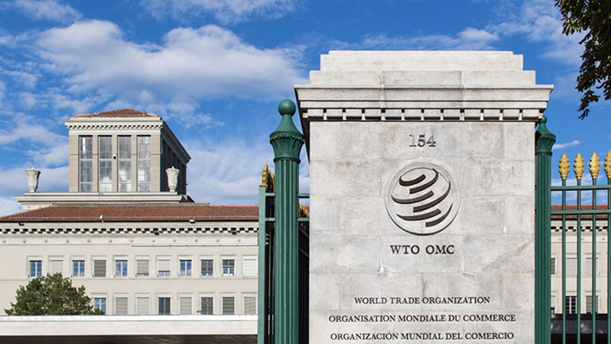
Applying and Getting into the WTO
WTO has many departments i.e. trade and environment, trade and development. You select up to three and rank your preferences. Generally would advise selecting the department you have a strong background in.
Fairly straightforward application. I submitted my workday application and resume and cover letter
Following my application I had a single panel interview with the team and some time later got the news I was in
Useful tips:
Keep your resume/CV to one page, and in both resume and cover letter, note the key skills that would be sought - research and writing, project management, ability to work in a multi-cultural environment. Highlight any trade courses you’ve taken or coursework.
It is useful to find a contact and send an email after submitting a generic application on workday - I sent an email to my division’s director

Slide 7
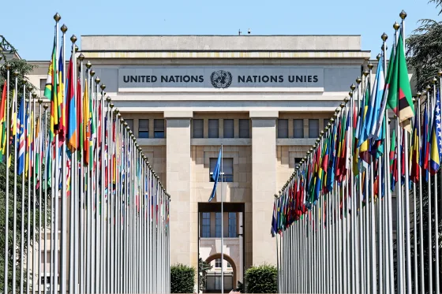
Entry-level roles in International Organisations
United Nations Secretariat
Internships
Across departments such as UNCTAD, UNITAR, etc.
As there’s so much variety and scope, you can apply for the department you’re most interested in and have a strong background with.
Young Professionals Programme (YPP)
Entry route into P-1 to P-2 professional roles. Often require that you have two years of work experience.
Other UN System Bodies
Specialised agencies (e.g. World Intellectual Property Organization, International Labour Organization) also offer internships and YPP-style programmes
Organisation for Economic Co-operation and Development (OECD)
Internships
Available for students completing a bachelor’s, master’s or PhD
Young Professionals Programme (YPP)
Two-year analytical/operational roles
Targeted at recent undergraduates
Other notable organisations: CERN, World Health Organization, International Trade Center, World Bank, Asian Development Bank, European Bank for Reconstruction and Development, International Telecommunication Union

Slide 8
Where to look for vacancies in this field?
Job Pages
Workday: Some internships run on a rolling basis . This is true for the WTO, so you may not see an advert, you would just need to go on the organization’s workday and apply. WIPO also has an internship roster.
LinkedIn: You can setup a job alert as well for organization’s your particularly interested in on Linkedin and follow them
Cold email: Sometimes there is no specific openings, but for internships if you can find someone’s contact, you can shoot them an email and express interest. This is also more effective if you have a reference.
https://www.linkedin.com/company/opportunities-for-youth-organization/posts/?feedView=all

Slide 9
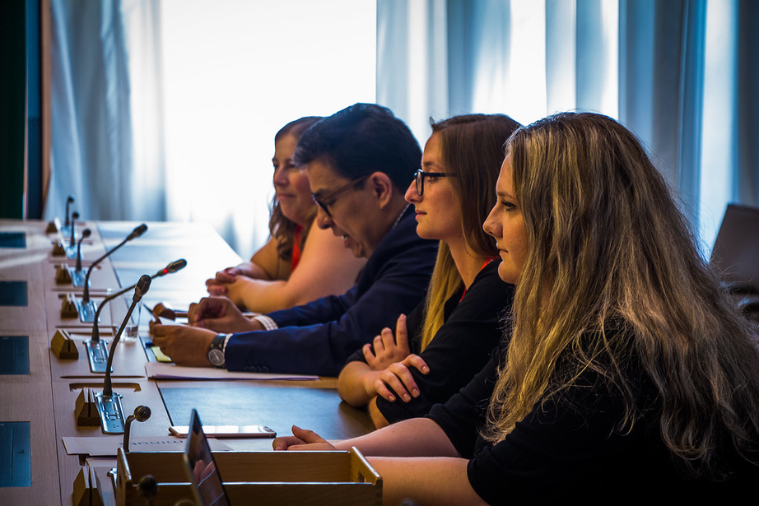
What types of coursework or prior internship/clinical experience tend to make candidates more competitive?
Useful experiences to have
Research tasks: For instance working as a research assistant to a professor. I worked in my Law school clinic but on a research based project.
Teaching experience: A lot of Organisations engage with capacity-building projects, developing educational content, so having experience teaching either as a tutor or in another capacity can be really useful.
Project/event management: A lot of organisations also function as a meeting point for government officials or other notable figures so having experience organising events can be useful to highlight.
Speaking engagements: Mooting, debate tournaments, or speaking in other conferences like TEDx can actually be really useful. Note the WTO has a mooting competition. There’s also the Nelson Mandela Human Rights Moot at the United Nations.

Slide 10

What types of coursework or prior internship/experience tend to make candidates more competitive?
I would also focus on
Academic modules: Highlight the modules that are linked to the role you’re applying for.
Academic achievements: I believe this is something that helps you stand out in the crowd, and this is something I would place front and centre as well on your resume.
Professional certificates: If you have any linked to the role you’re applying for this can be really useful. You can complete one on FutureLearn or on edx to demonstrate you have the skill or knowledge they’re seeking.
Languages: If you’re keen on working in this field, it’s definitely advisable to polish up language skills.
Note, if you’re a lawyer, not being qualified in a jurisdiction doesn’t impact your competitiveness really.

Slide 11
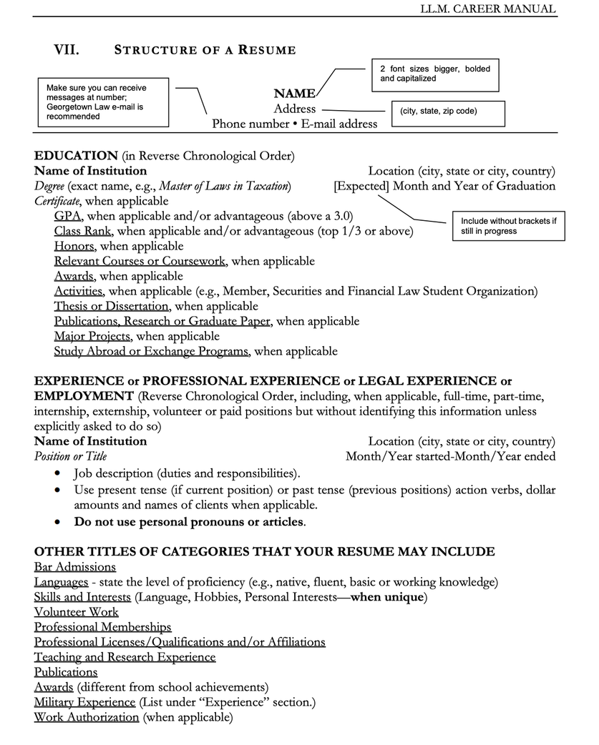
Ideal resume and cover letter formats
Generally keep your resume and cover letter simple. One page.
Make it clear, legible, and don’t overthink it too much.
Do tailor it to the job application.
I would use my University’s (Georgetown Law) templates for both my resume and cover letter, just filling it with my own details and I’ve found that works fairly effectively in this field.
I then used CareerSet to ensure my resume is strong and well tailored to the role.
https://www.law.georgetown.edu/wp-content/uploads/2021/08/2021-2022-Office-of-Graduate-Careers-LL.M.-Career-Manual.pdf

Slide 12

Any Questions?

